Slide 1
SURGICAL TREATMENT OF CARDIAC TUMORS
IN BLACK AFRICANS: REPORT OF 13 CASES
Mve Mvondo C, Kobe Fokalbo Z, Ngo Yon Laurence C, Tsague Kengni HN, Ela Bella A,
Dakleu M, Djientcheu VDP and Ngowe Ngowe M
Division of Cardiac Surgery, Cardiac Centre Shisong, Kumbo, Cameroon
Department of Surgery, Faculty of Medicine and Pharmaceutical Sciences, Douala, Cameroon
Department of Cardio-thoracic and Vascular Surgery, Yaoundé General Hospital, Yaoundé, Cameroon

Slide 2
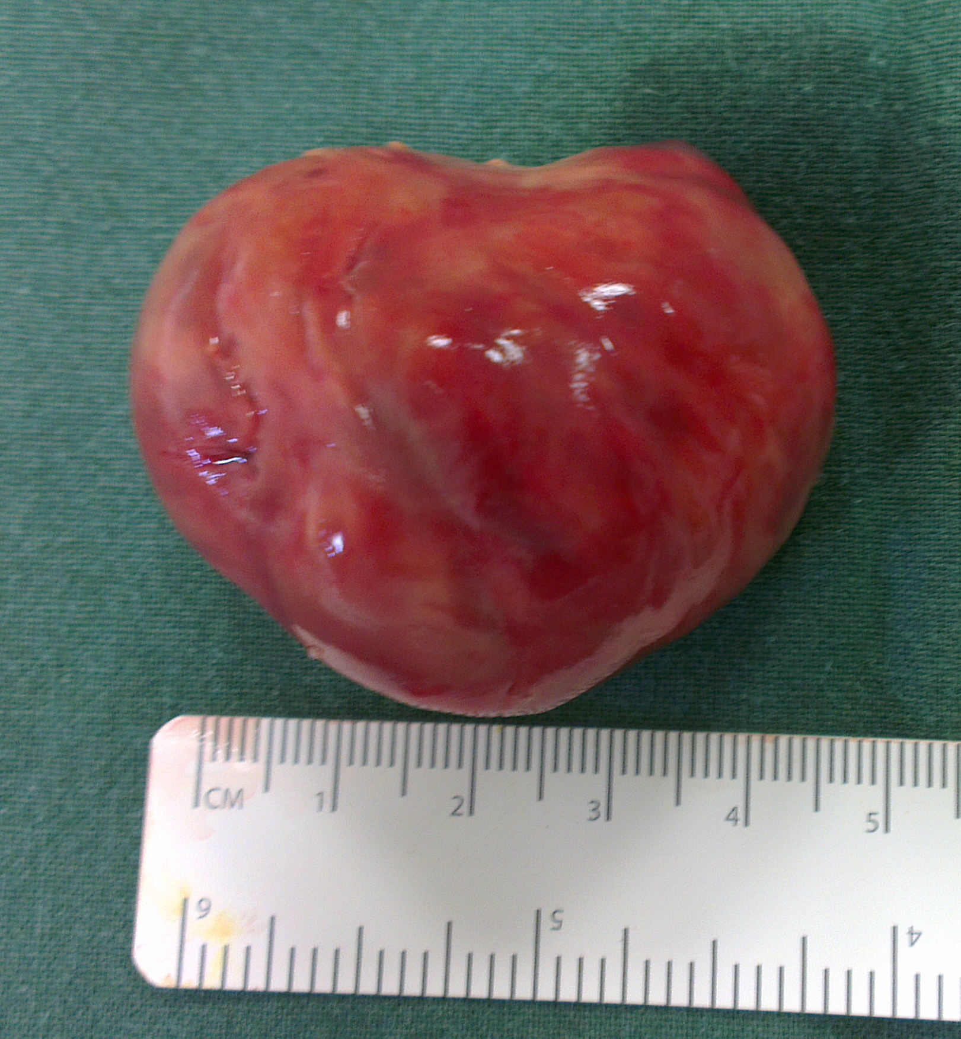
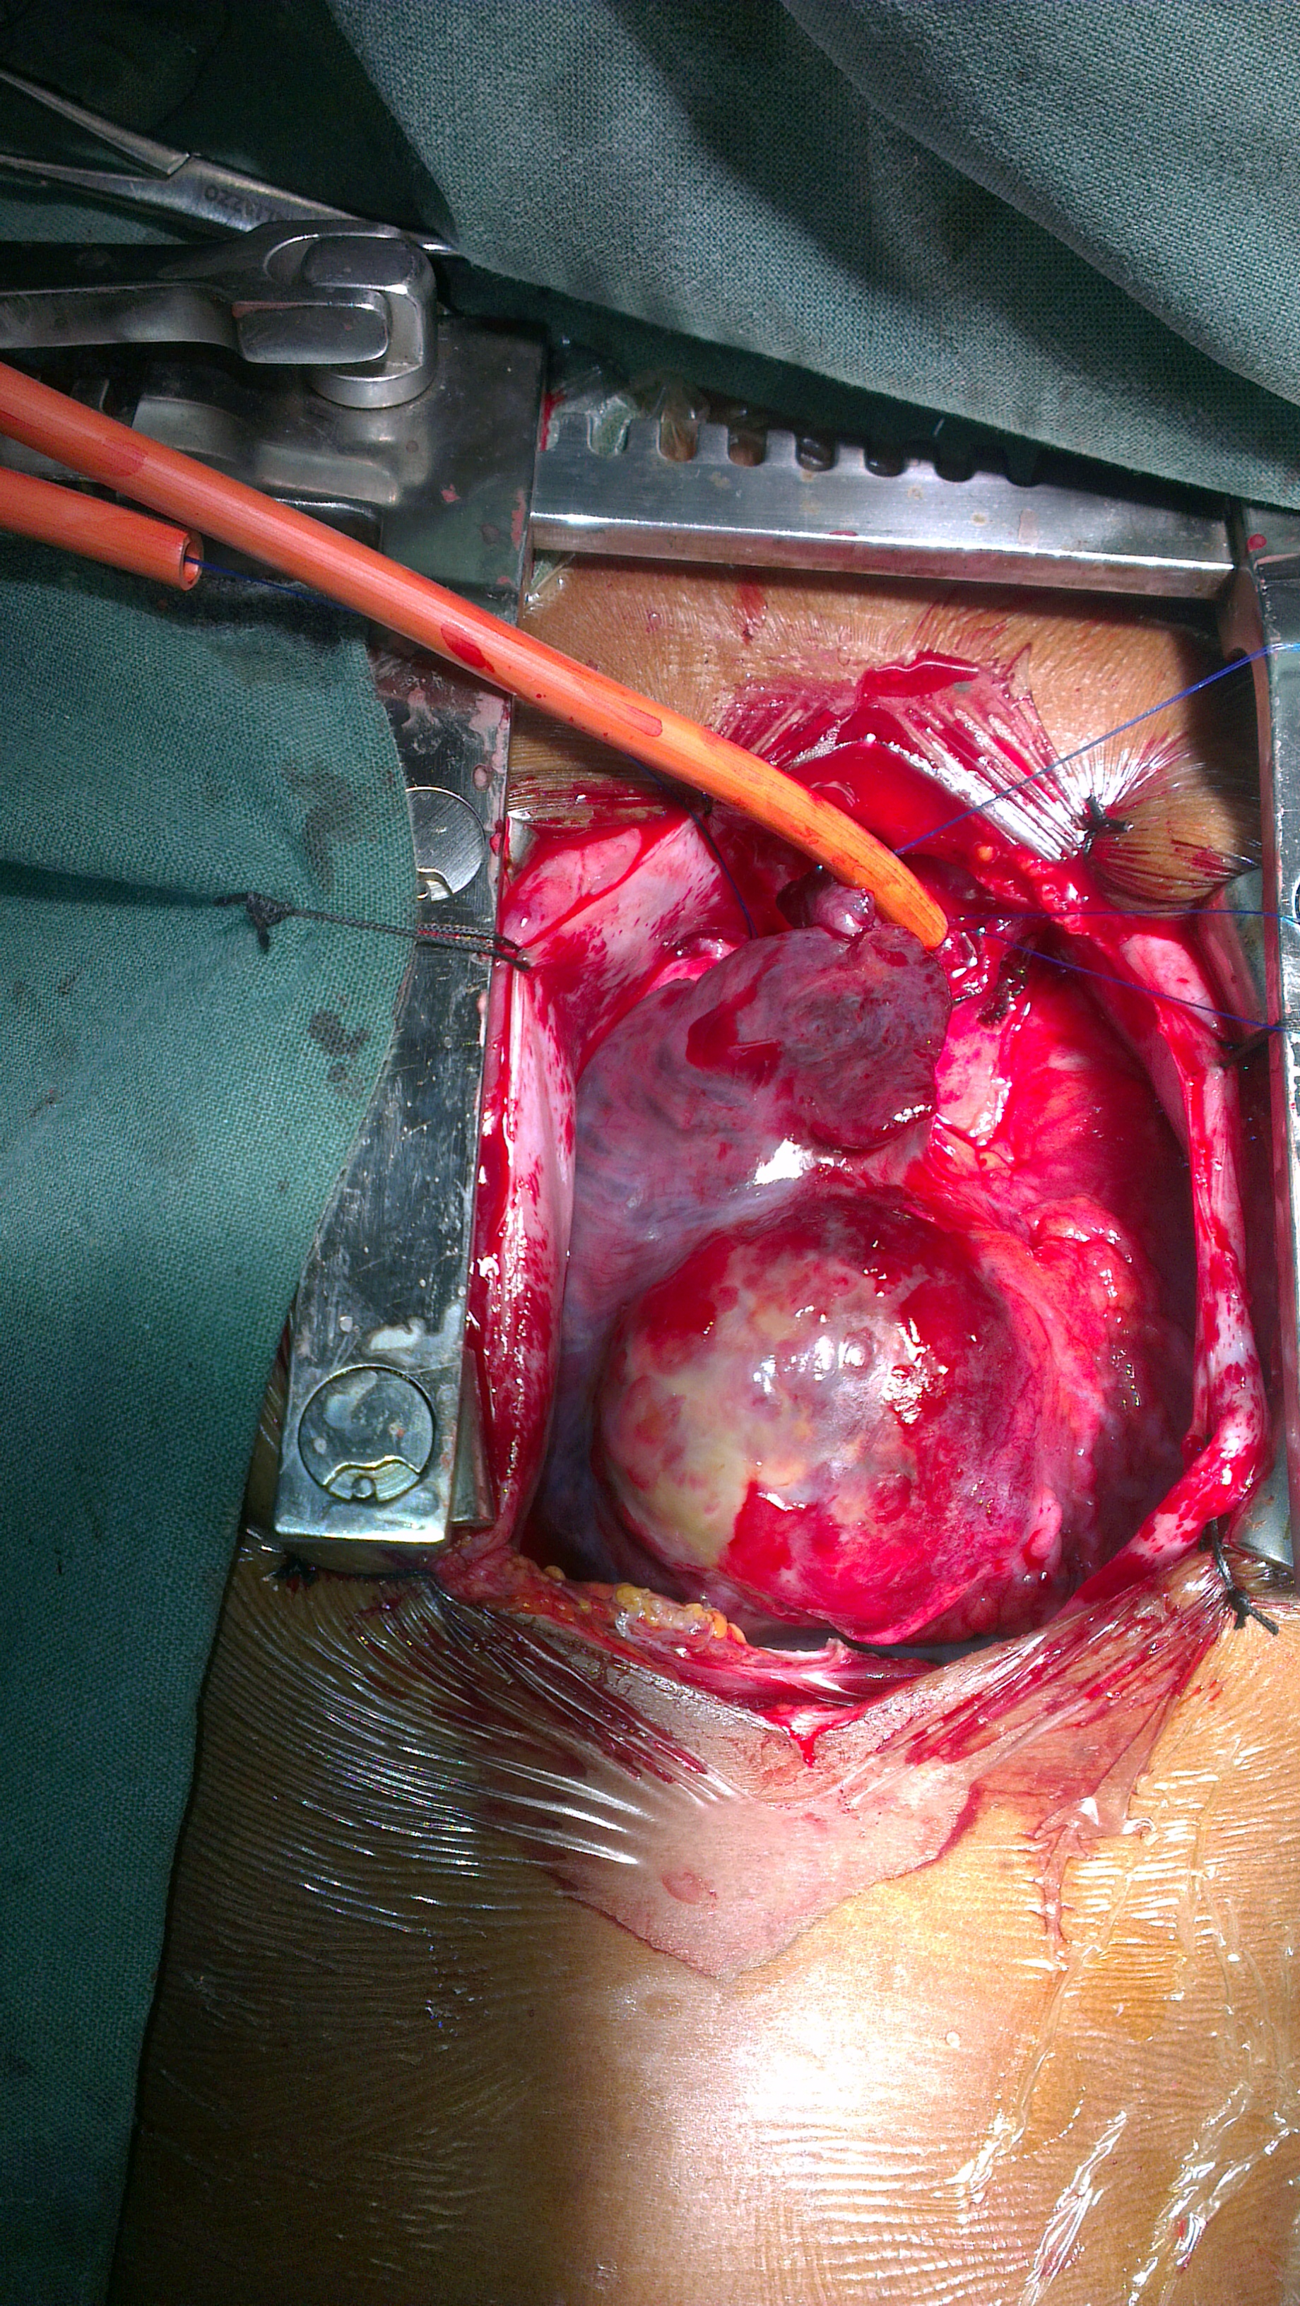
Background
Few studies on cardiac tumors (CT) have been made in sub-Saharan Africa with regards to their surgical treatment
Our study reviews the early clinical outcomes of 13 patients who underwent surgical removal of CT in our institution over a 12-year period
Patients and Methods
Between November 2009 and december 2021, a total of 13 patients underwent surgical treatment of CT at the division of cardiac surgery of the Shisong Cardiac Center
Patients’ sociodemographic, clinical and surgical data were retrospectively analysed
Results
The mean age at surgery was 53.2 ± 18.5 years (range : 14 – 69 years)
Only two patients had < 20 years of age (15.3%) whereas 76.9% had > 50 years
Female gender was predominant with a sex ratio (M/F) of 0.30

Slide 3
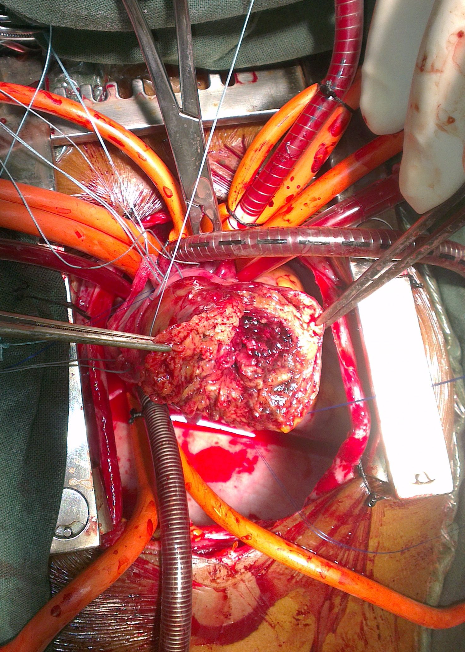
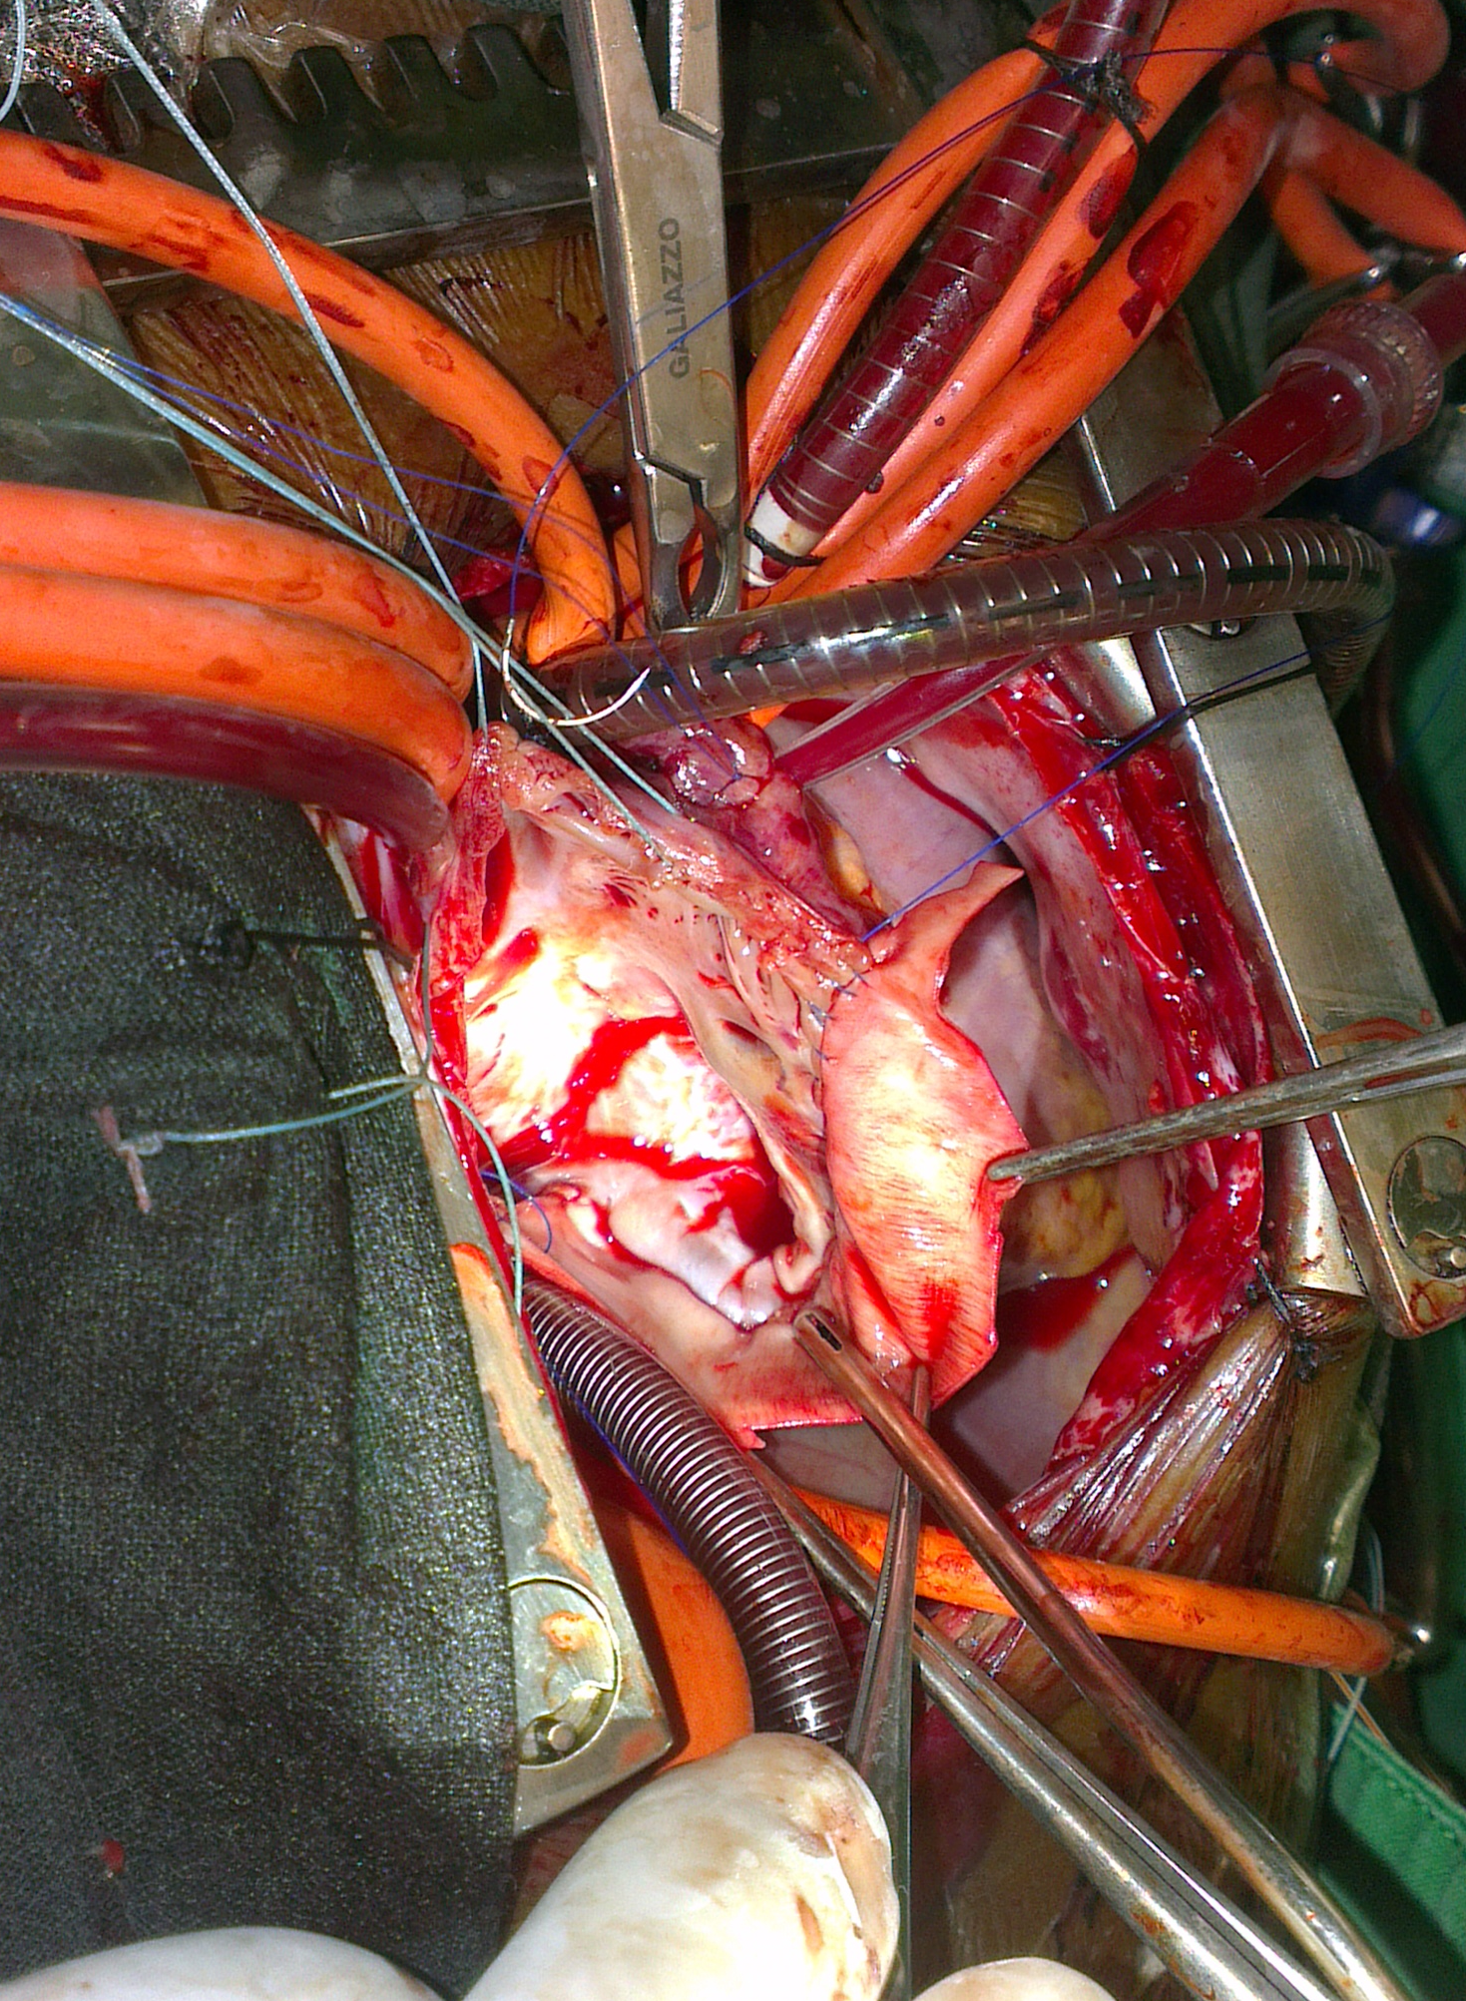
Results
The types of tumors were : atrial myxoma (n=10, 76.9%), primary malignant tumors (n=2, 15.3%) and right atrial diffusion of hepatocellular carcinoma (n=1, 7.6%).
Associated procedures: mitral valve surgery (38%), tricuspid valve annuloplasty (15%).
The mean cardiopulmonary and cross-clamping times where 88.3 ± 38.2 and 57.8 ± 28.5 minutes respectively
The operative mortality was 7.6% (n=1/13)
The mean hospital length of stay was 5.2 ± 3.4 days
Conclusion
CT in SSA patients are often benign and mainly affect female patients in their 50s
Early diagnosis and agressive resection improve the early outcomes

